Slide 1



Slide 2


Introducing
EasyCarts
Making lives easier

Slide 3

Service
Always Matters
Positioning Statement
For working professionals and students across America who shop at Walmart on a weekly basis, Walmart Plus offers a recurring order option on pre-saved carts that make shopping for daily essentials more convenient and time saving

Slide 4

Vision
To become the worldwide leader in consumer shopping.
Mission
To make shopping easy, affordable and convenient so that everyone can live better.

Slide 5


Product
Highlights
Walmart EasyCarts would further simplify the shopping experience for Walmart Plus users.
The Primary purpose of this feature is to automate daily grocery ordering via the Walmart app.

Slide 6
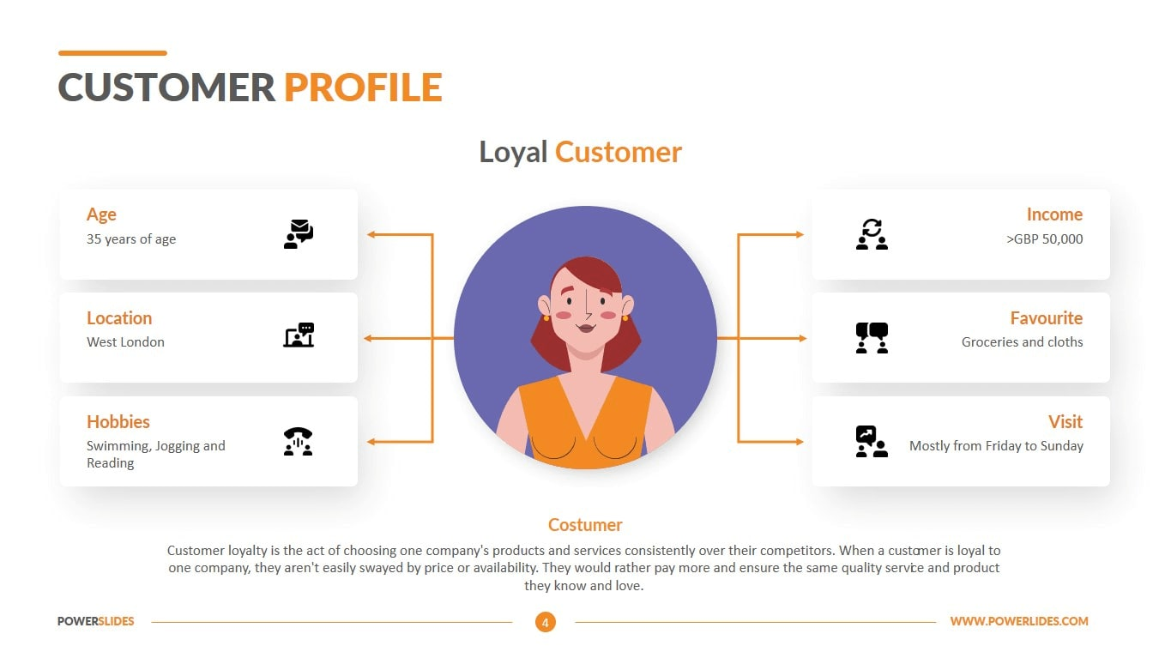

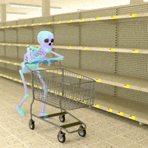
Customer Profile
Working Professional
Age
Average
25-40
$29,000 - $61,000
Location
Favorites
United States
Hobbies
Visits
Pain Points
Runs out of grocery.
Schedule grocery trips in the middle of the week.

Slide 7

Customer Profile
Student
Age
Income
18-25
15,000$
Location
Favorites
United States
Hobbies
Visits
Pain Points
Unpredictable schedules for grocery shopping.
Perishable nature of bulk buys.

Slide 8







Product Positioning
Number of Monthly Active Users
Subscription Affordability (Annual)
Source : Apptopia.com
Notes:
Walmart – 141 million (MAU) , 46 million (DAU), 98$
Amazon – 120 million 139
Target – 18 Million. 99
Instacart – 5.24 Million 99
Costco – 3.0 Million 120
Doordash – 15.41 MILLION. 96
Kroger – 1.8 Million 59

Slide 9


Product Roadmap
Our First Day
2020
September
Largest Market share for Groceries with good user traffic on both the website and application.
Increasing the Online Presence and establish dominance.
2022
Research Phase
August
1.Conducted Survey and one to one Feedbacks.
2. Understood the needs of the Target customer demographic.
3. Analyzed Sales Trend and Defined Sales Territories.
4. Competitor Analysis.
5. Built Customer Personas.

Slide 10


Setting up
2022
October
Implementation, testing and feature Go-live
Cost and Complexity Drivers.
Development of a recommendation engine based on Market Basket Analysis.
Setting up Dedicated Delivery Partners.
2022
Marketing Campaign
December
Streamline Digital Campaign Management.
Dedicated Marketing Prioritization of Easycarts across all outlets and web platforms.
Email Drip Campaigns.
Adwords Optimization.

Slide 11



Beta Launch
2023
January
Feature Launch for Existing Walmart + users on Mobile App and website.
Review Early KPIs.
Forecast Sales
Customer Feedback
2023
Extension Launch
March
Extension improvement implementation based on the feedback.
Evaluate and update sales targets and Online market presence.
Addition of Dashboards for ease of accessibility and improved product allocation.

Slide 12


UX
IMPROVEMENTS

Slide 13
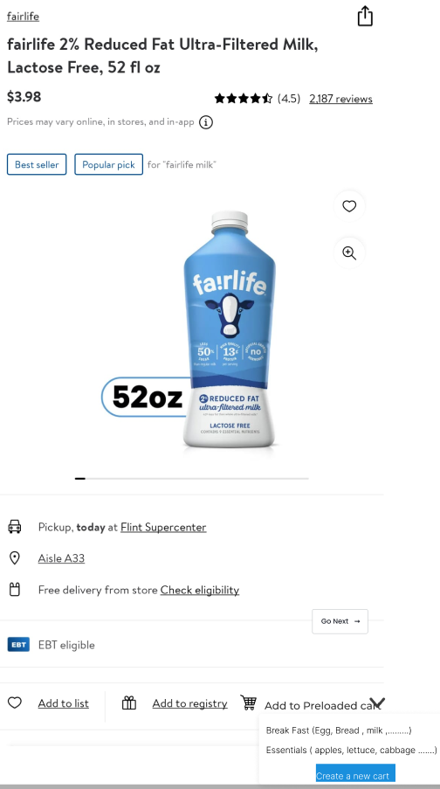
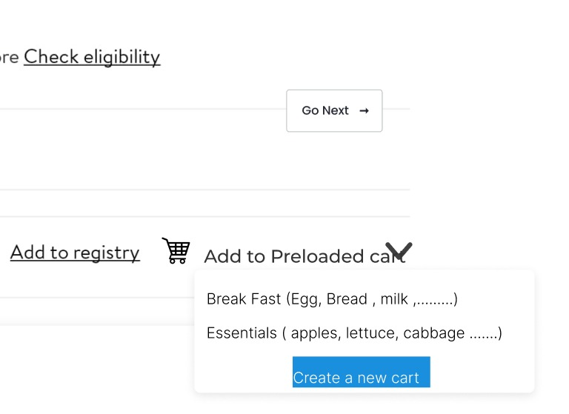
Item Page

Slide 14
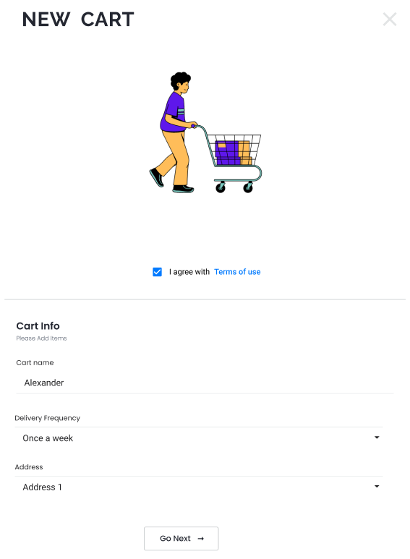

Slide 15
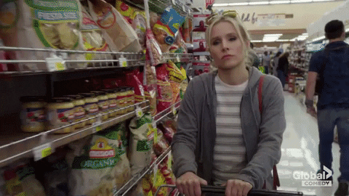
S
W
O
T
Affordability & Convenience
Large distribution & supply chain network
Well-established legacy
Less high-value ticket customers
Extremely intensive supply chain
Possibility of demand & supply mismatch
Increase in online customer base
Better demand forecasting inclusion of local business
Easy to duplicate model.
AMAZON

Slide 16
Thank
You
Making lives easier

